Slide 1
K-means Clustering
Mario GONZÁLEZ & Lale ASALIOGLU

Slide 2
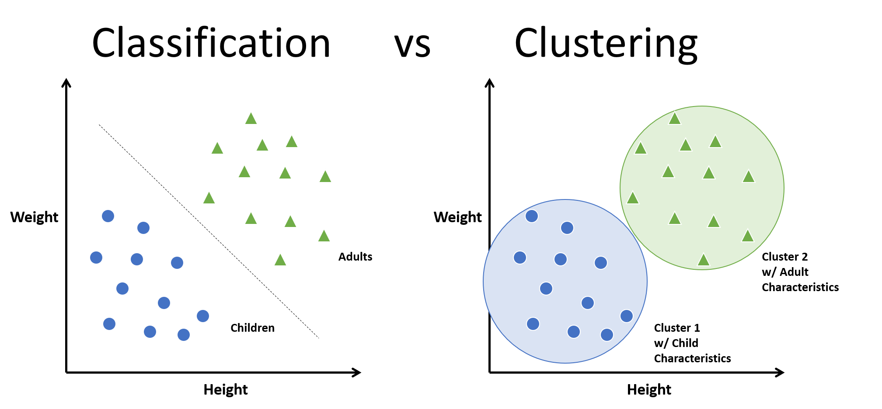
What is Clustering?
Clustering refers to the process of generating labeled groups of data based on how similar they are. Clustering is similar to Classification, but not quite the same…
Characteristics
Clustering is a
Classification vs Clustering

Slide 3
Hello World!

